Slide 1

ADVANCED ANALYSIS OF THE PERSONAL LOAN MODELING DATASET
GROUP 2
Marketing Department-Thera Bank

Slide 2
MEMBERS-GROUP 2
Asel Kandewatte - s13994
Saumya Karunadhika - s13995
Danushka Suwaris - s14024

Slide 3
TABLE OF CONTENTS
01
DATA PRE-PROCESSING
04
MARKET ANALYSIS
02
DESCRIPTIVE ANALYSIS
05
ISSUES ENCOUNTERED
03
ADVANCED ANALYSIS
06
MARKET PLAN

Slide 4

OBJECTIVES
OBJECTIVE 1
OBJECTIVE 2
To construct a suitable model to predict whether a customer will accept the Personal Loan offer based on customer demographic information and their relationship with the bank.
To identify the potential clients for loans by minimizing loss of resources and opportunities.

Slide 5

Description of the Dataset
The dataset obtained from last year campaign contains observations from 5000 customers and 14 variables. The data include customer demographic information (age, income, etc.), the customer's relationship with the bank (mortgage, securities account, etc.), and the customer response to the last personal loan campaign
No. | Variable | Description
1 | ID | Customer ID
2 | Age | Customer's age in completed years
3 | Experience | Number of years of professional experience
4 | Income | Annual income of the customer ($000)
5 | ZIP Code | Home Address ZIP code.
6 | Family | Family size of the customer
7 | CCAvg | Avg. spending on credit cards per month ($000)
8 | Education | Education Level. 1: Undergrad; 2: Graduate; 3: Advanced/Professional
9 | Mortgage | Value of house mortgage if any. ($000)
10 | Personal Loan | Did this customer accept the personal loan offered in the last campaign?
11 | Securities Account | Does the customer have a securities account with the bank?
12 | CD Account | Does the customer have a certificate of deposit (CD) account with the bank?
13 | Online | Does the customer use internet banking facilities?
14 | CreditCard | Does the customer use a credit card issued by this Bank?

Slide 6

01
Data Pre-Processing

Slide 7

Data Cleaning
01
03
The variable “ID” does not add any benefit to the analysis, so it was removed.
There were 427 unique zip codes available and some zipcodes were not existing. Thus, the variable ZIPCode was removed
02
Converted the mortgage variable to a categorical variable such that 1 indicates customers with mortgage and 0 indicates customers without mortgage.
Some values of the variable “Experience” were negative and converted them into their absolute values.
04

Slide 8

02
Important results of the Descriptive Analysis

Slide 9
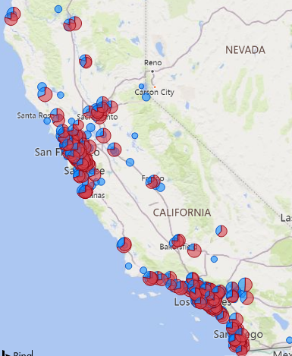
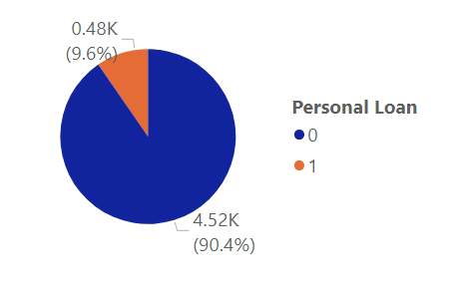
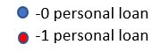
1.The conversion rate of the personal loan marketing campaign is 9.6%.
2. Average income is very low in some parts of the country where none of the customers have obtained a personal loan.

Slide 10
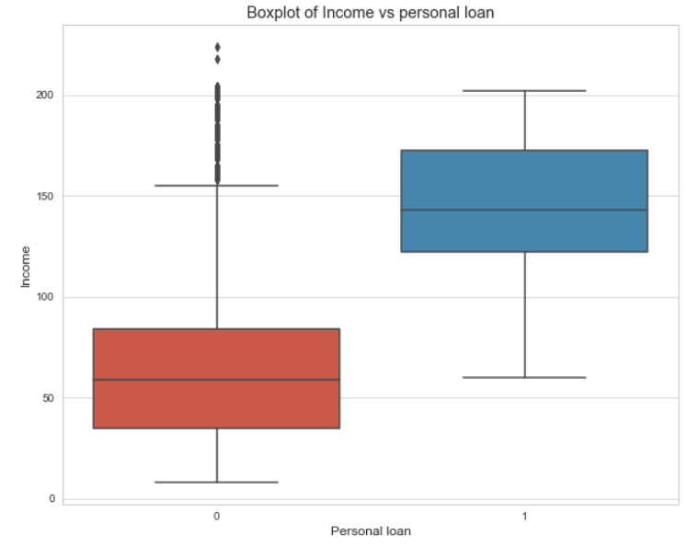
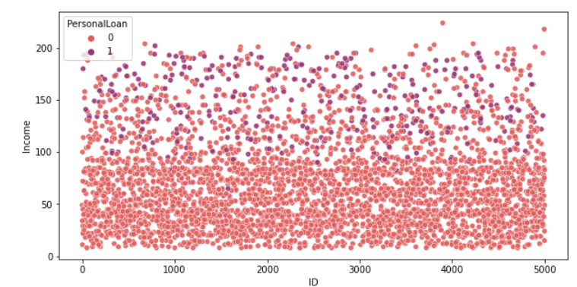
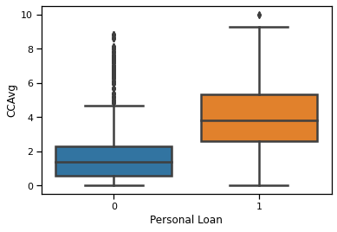
3. The median income of customers who have applied for personal loans is higher than that of customers who haven’t applied for personal loans.
4. Customers who have a high average spending on Credit Card per month have decided to get a Personal Loan offered in the last campaign.

Slide 11
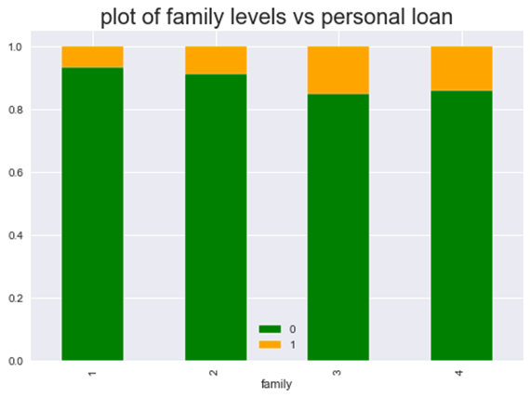
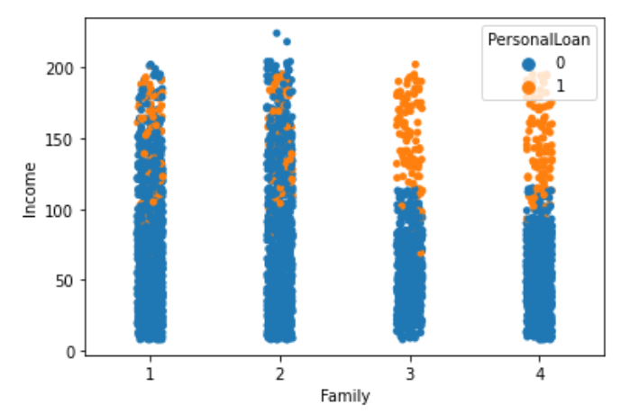
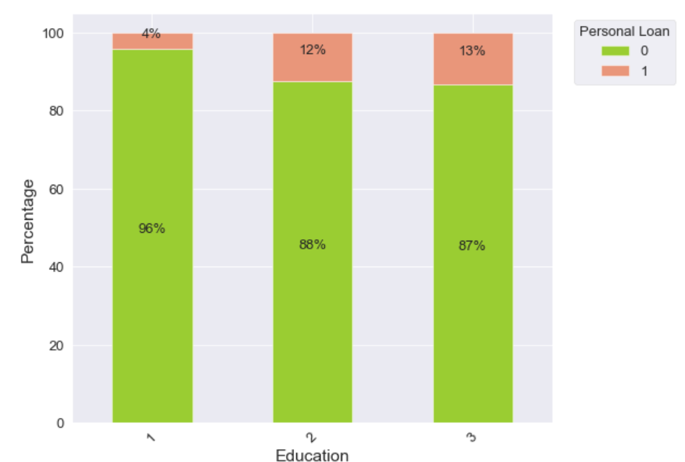
5. There is an interesting pattern that shows larger families feel the need to get personal loans more. Only the higher income families out of the families of larger sizes have obtained a personal loan.
6.The customers with Advanced/professional education (3) have accepted the personal loan more than the undergraduates (1) and graduates (2)

Slide 12
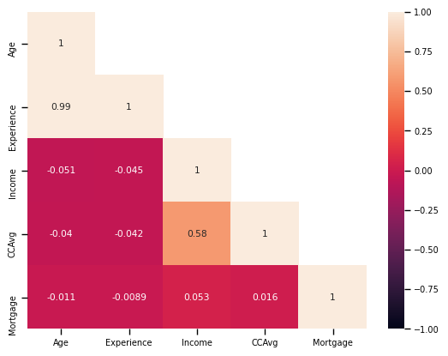
7. Age seems to be positively associated with
Experience.
These associations signal us about the Multi-collinearity in data.
8.Perform under-sampling and over-sampling techniques

Slide 13
03
Advanced Analysis

Slide 14

Our main objective through this analysis is to identify the potential clients for loans without losing any potential customer opportunity.
Should avoid both:
Loss of resources
Loss of opportunity

Slide 15


—Ruchi Toshniwal Analytics Vidhya
Why F1 Score????
“F1 Score is used when we need to seek a balance between precision and recall“
Cost of False Positive= Cost due to loss of resources (marketing)
Cost of False Negative= Cost due to loss of opportunity (good APR/ Interest Rates to potential loan customers).

Slide 16


Logistic Regression with
Shrinkage Techniques
Model | Accuracy | F1 Score
 |  | 0 | 1
Logistic
Ridge | 0.942 | 0.9680 | 0.6882
Lasso | 0.943 | 0.9689 | 0.6952
Elastic Net | 0.921 | 0.9566 | 0.5587
The class 1 F1 Score is very low compared to the 0 class.

Slide 17

KNN and SVM
Model | Accuracy | F1 Score
 |  | 0 | 1
KNN | 0.938 | 0.9662 | 0.6265
SVM | 0.965 | 0.9807 | 0.8087
F1 score is comparatively small for the class 1 which represents the customers who accept the personal loan offers.
!!!!!
Our attention was given to discover further methods to increase the F1 Score of the 2 classes

Slide 18
Tree Based
models

Slide 19

Summary…..
Model | Accuracy | F1 Score
 |  | 0 | 1
Bagged-Decision Trees | 0.9850 | 0.99 | 0.93
Random Forest | 0.9830 | 0.99 | 0.92
Gradient Boosting | 0.9850 | 0.99 | 0.93
XGBoost | 0.9890 | 0.99 | 0.95
We can observe that the F1 score for both classes have drastically increased for the tree based models.

Slide 20

Treating Unbalanced Data
SMOTE
Random under-sampling
Random under-sampling with SMOTE

Slide 21
Summary…..
Model Fitted | SMOTE |  |  | Under Sampling |  |  | Under Sampling+SMOTE
 |  | F1 Score |  |  | F1 Score |  |  | F1 Score
 | Accuracy | 0 | 1 | Accuracy | 0 | 1 | Accuracy | 0 | 1
Logistic with
Ridge | 0.864 | 0.92 | 0.60 | 0.877 | 0.93 | 0.61 | 0.875 | 0.93 | 0.62
Lasso | 0.864 | 0.92 | 0.60 | 0.869 | 0.92 | 0.6 | 0.885 | 0.93 | 0.64
Elastic Net | 0.860 | 0.92 | 0.58 | 0.857 | 0.91 | 0.58 | 0.921 | 0.96 | 0.56
KNN | 0.898 | 0.94 | 0.60 | 0.822 | 0.89 | 0.53 | 0.894 | 0.94 | 0.6
SVM | 0.901 | 0.91 | 0.75 | 0.936 | 0.96 | 0.76 | 0.918 | 0.95 | 0.71
Bagged Decision Trees | 0.974 | 0.99 | 0.88 | 0.984 | 0.98 | 0.75 | 0.972 | 0.98 | 0.88
Random Forest | 0.981 | 0.99 | 0.90 | 0.961 | 0.98 | 0.75 | 0.976 | 0.99 | 0.7
Gradient Boosting | 0.981 | 0.99 | 0.91 | 0.968 | 0.98 | 0.87 | 0.979 | 0.99 | 0.91
XG Boosting | 0.979 | 0.99 | 0.91 | 0.967 | 0.98 | 0.87 | 0.974 | 0.99 | 0.89
The combination of SMOTE and under-sampling performs better than plain under-sampling.
N.V. Chawla (2011)

Slide 22

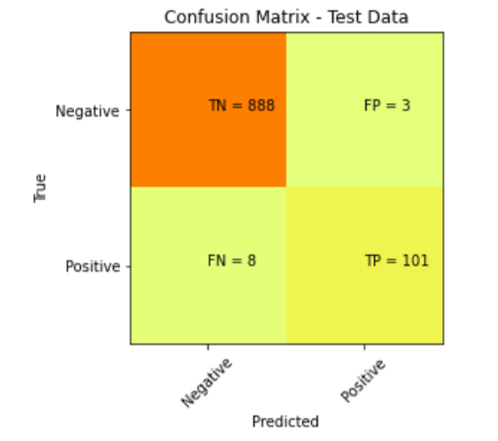
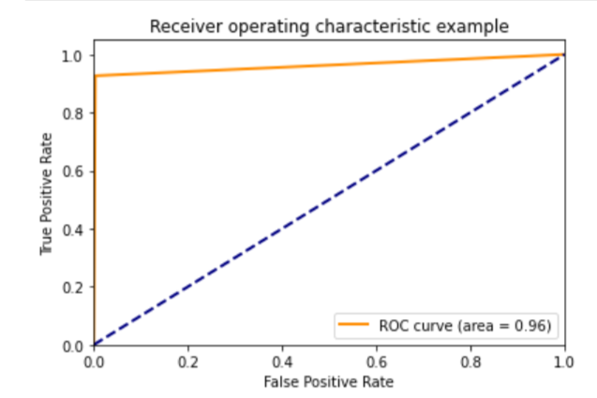
The Final Model
XGBoost
Loss of opportunity: 0.8%
Loss due to waste of resources: 0.3%
Tuned Parameters:
learning_rate | 0.1
max_depth | 7
n_estimators | 1000
subsample | 1.0
F1 Score
0 | 1
0.99 | 0.95
AUC
0.96

Slide 23
Overall Accuracy 98.9%

Slide 24
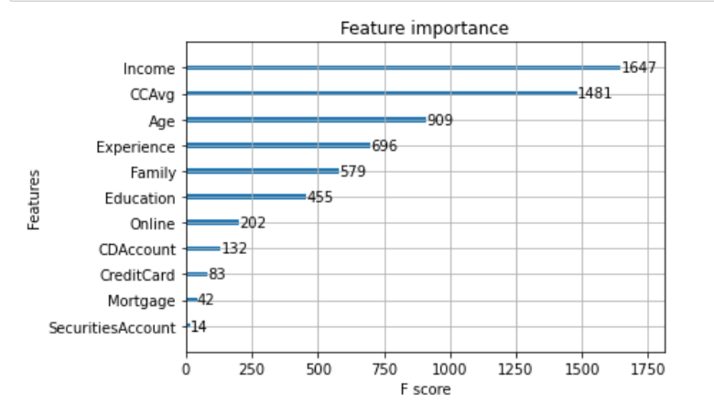
The Most Important Variables
Tip!
Focus more on income and CCAvg rather than focusing on customers who use credit-cards and do online payments.
Model ranks the variables income and CCAvg as more important than the other variables.

Slide 25

MARKET ANALYSIS USING PARTIAL DEPENDENCIES

Slide 26

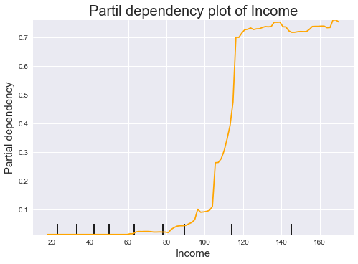
The probability of obtaining a loan is very low for customers with an income ranging from $0 to $50,000 and has increased slightly after passing the income mark of $50,000 and also it shows a very high increment after $100,000.
INCOME

Slide 27
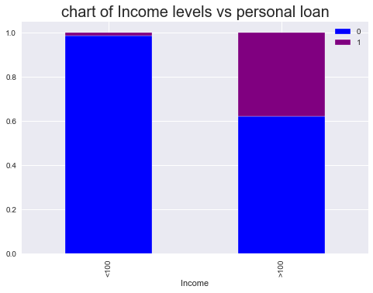
-Forbes Advisor journal-
“Lenders impose income requirements on borrowers to ensure they have the means to repay a new loan.”
As per Ascent personal loan statistics, Americans with income over $100,000 are more likely to consider taking out a personal loan than those with lower incomes.

Slide 28

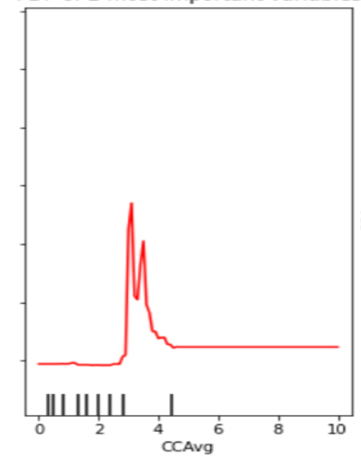
Though the probability of a customer obtaining a loan has increased with monthly average credit card spending, there are some sudden drops
AVERAGE CREDIT CARD SPENDING
This Photo by Unknown Author is licensed under CC BY-SA-NC

Slide 29

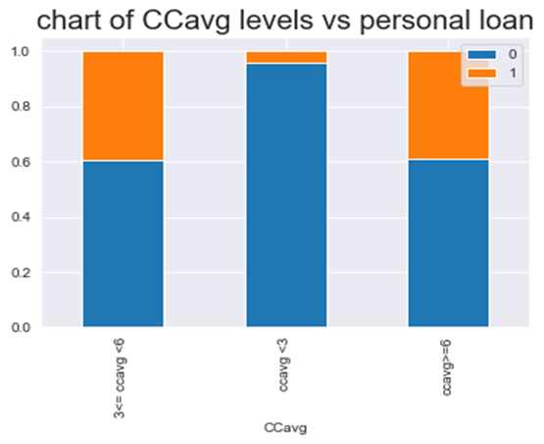
Reasons
Reasons for the sudden drops:
Reason for the increment:
Due to the smaller number of observations representing some of the CCAvg values.
The solution for the high interest rates of credit cards is to use a personal loan to consolidate the credit card debt into one monthly payment.
Due to high accumulated credit card average spending; the customers may not be able to afford to repay the personal loans with an interest.
!!!!!!
In these circumstances, it is important to refrain targeting such customers since they are unreliable.
When the credit card spending is high there is a high possibility of unpaid bills and high credit card balances.

Slide 30
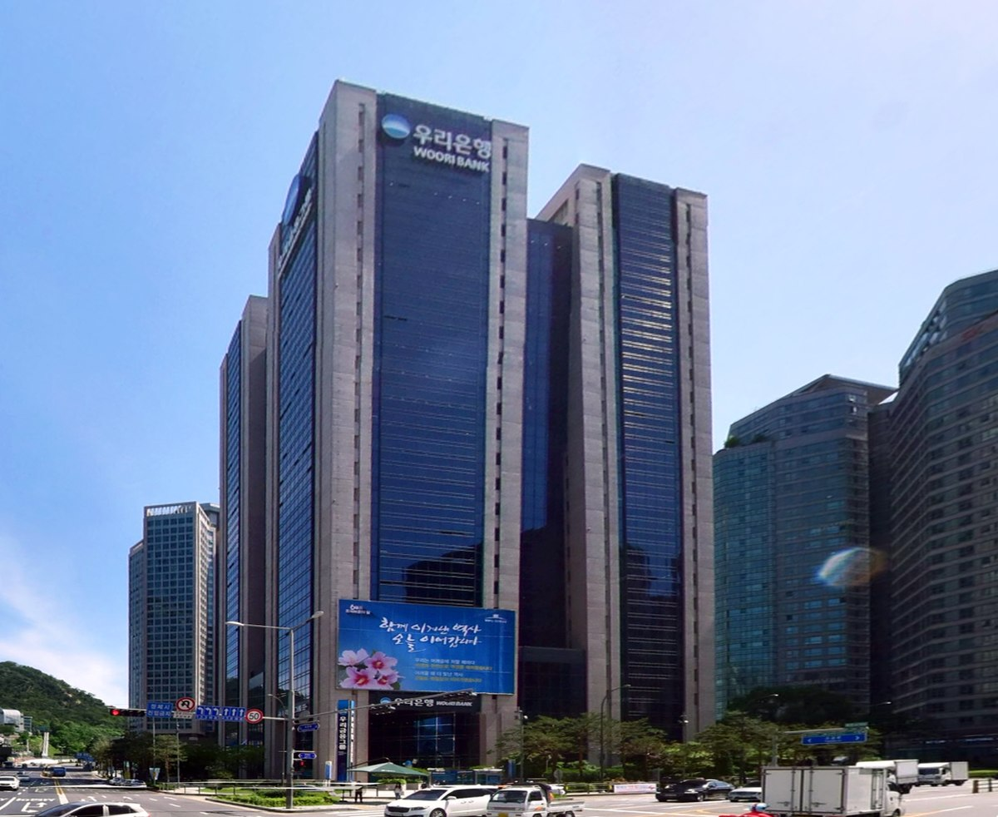

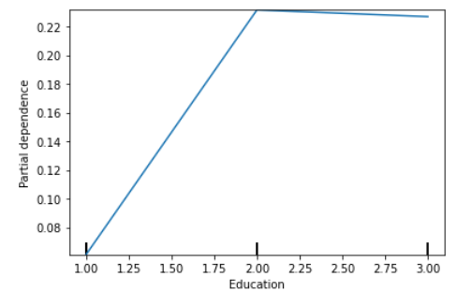
The probability of obtaining a loan differs with the education in a way that when the education qualification increases, there is a higher chance of a customer obtaining a loan.
EDUCATION
This Photo by Unknown Author is licensed under CC BY-SA

Slide 31

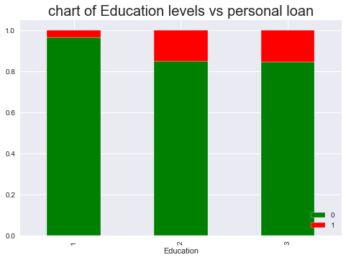
Reasons: Education
Undergraduates, they may not find it necessary to buy a personal loan to fund their education due to the scholarship offers.
The undergraduates do not have a proper source of income to repay the loans.
Higher the education level the more the customer is confident and open to opt for personal loans.

Slide 32

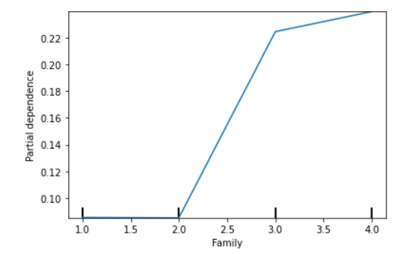
The family size plays a major role in predicting the potential loan customers. When the family size increases, the probability of a customer obtaining a loan also increases Larger families feel the need to get personal loans more since the expenses of large families are high.
FAMILY SIZE

Slide 33
ISSUES ENCOUNTERED AND PROPOSED SOLUTIONS
01
02
03
The F1 score for class 1 was low for
logistic regression models
KNN
SVM
The Trees tends to over fit the data
The dataset was imbalanced with only 9.6% of the customers in the loan obtained class
F1 score of both the classes increased after fitting tree-based models
Used hyper parameter tuning grid for each Tree based classifier.
Under-sampling
SMOTE
under-sampling with SMOTE

Slide 34

MARKETING PLAN

Slide 35

HIGH PROFILE CUSTOMERS
INCOME
01
02
CCAVG
EDUCATION
03
04
Family Size
Higher than $100,000
$3000-$4000
Advanced/Professional Level and Graduates
Greater than 2
This will lead to avoid loss of opportunities and loss of resources!

Slide 36

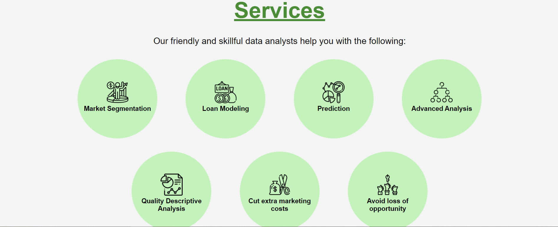
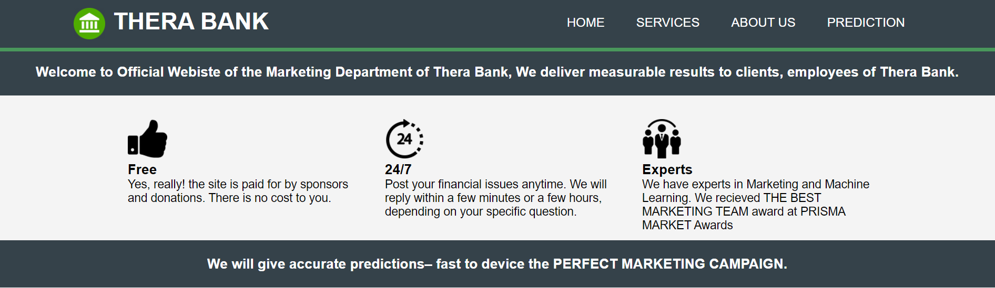
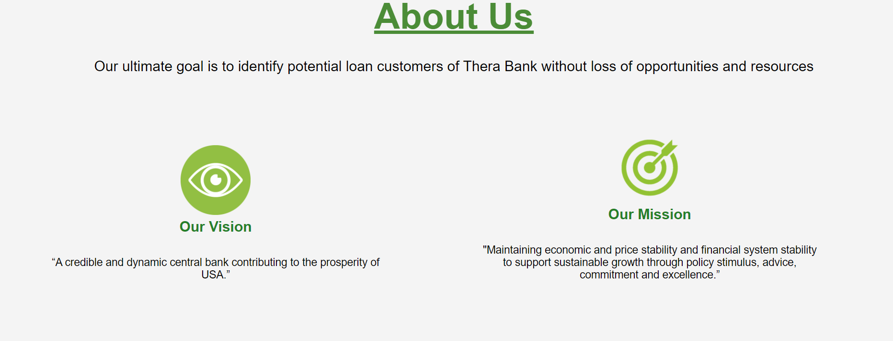
GLIMPSE OF OUR DATA PRODUCT
Visit: https://therabank.herokuapp.com/

Slide 37
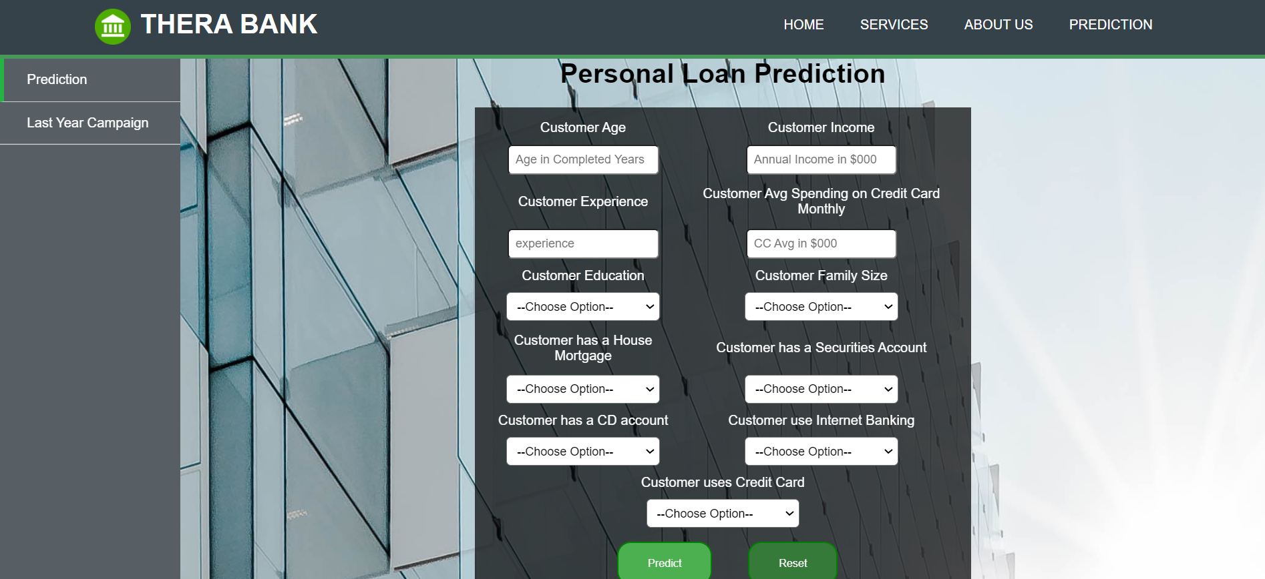
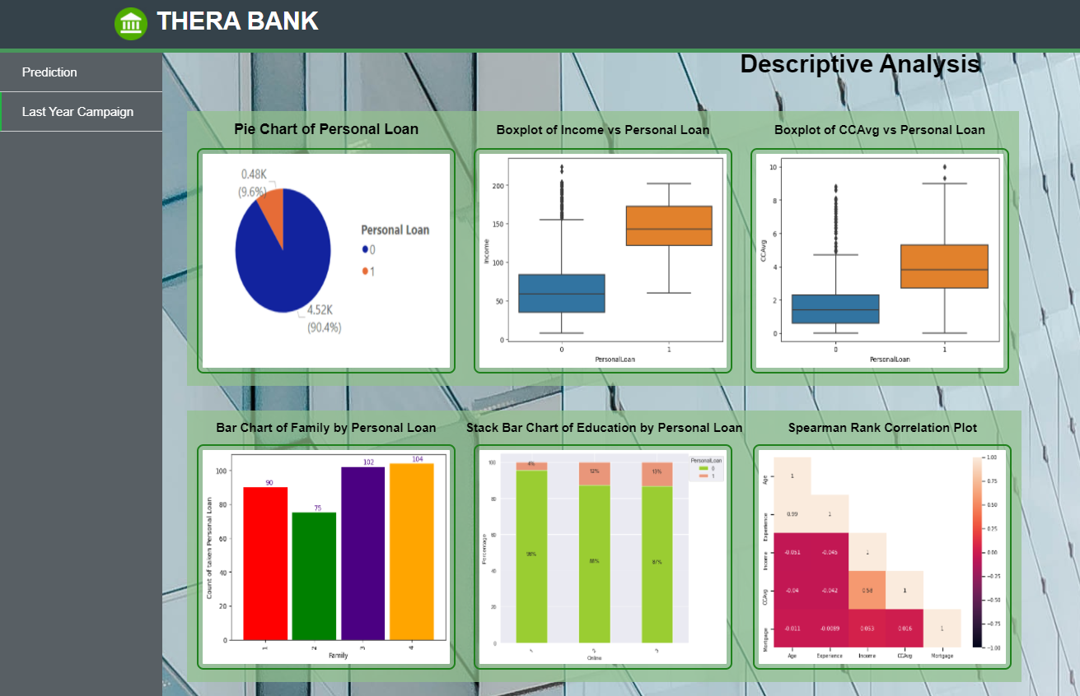

GLIMPSE OF OUR DATA PRODUCT
Visit: https://therabank.herokuapp.com/

Slide 38



OBJECTIVE 1
OBJECTIVE 2
To construct a suitable model to predict whether a customer will respond to a Personal Loan Campaign based on customer demographic information and the customer’s relationship with the bank.
To identify the potential clients for loans by minimizing loss of resources and opportunities.
TARGET ACCOMPLISHED

Slide 39
REFERENCES
Marketing Ideas for Loan Companies: Better Personal Loan Advertisement. (n.d.). Retrieved June 22, 2021, from https://www.msp-pgh.com/personal-loan-marketing-ideas-for-loan-companies/
Personal Loan Statistics for 2020 | The Ascent. (n.d.). Retrieved June 23, 2021, from https://www.fool.com/the-ascent/research/personal-loan-statistics/
Personal Loans for Debt Consolidation: What’s The Average Amount? (n.d.). Retrieved June 22,2021, from https://www.cnbc.com/select/average-personal-loan-amount-for-debt-consolidation/
6 Things To Know About Personal Loans | Credit Karma. (n.d.). Retrieved June 24, 2021, from https://www.creditkarma.com/personal-loans/i/what-you-should-know-about-personal-loans
How much debt Americans have at every age. (n.d.). Retrieved June 22, 2021, from https://www.cnbc.com/2018/08/20/how-much-debt-americans-have-at-every-age.html
Grants | Federal Student Aid. (n.d.). Retrieved June 24, 2021, from https://studentaid.gov/understand-aid/types/grants
Securities Analysis: Investment Risks and the SIE - dummies. (n.d.). Retrieved June 26, 2021, from https://www.dummies.com/test-prep/securities-analysis-investment-risks-and-the-sie/
Good Reasons for Personal Loans. (n.d.). Retrieved June 26, 2021, from https://howmuch.net/articles/why-do-americans-take-out-personal-loans

Slide 40
Thank You!

